Slide 1
CAR Calibration Meeting CAR Review
AP Team
Funny Li, Ravi V, Matthew Kim, J.Y. Lee and Kila Yang
February 2014

Slide 2
CAR# 133912082
This CAR was initiated by CNAS in Chinese. CNAS auditor didn’t accept first hand testing data was recorded in laptop directly, so it’s concluded the data was not recorded at the time of testing.
This CAR was handled by Erica Qin as trainee, supported and reviewed by Kyle Huang.
.
 | CAR Number: | 133912082 |  | Open Date: | 2013-06-26
 | Originator: | Erica Qin |  | Initiator: | Erica Qin
 | CAR Source: | CNAS |  | Finding or Observation? | Finding
 | Audited Region: | Asia |  | Site Audited: | GUZ- Guangzhou, China
 | Audit Number: | 2013-276 |  | Auditor's Finding#/Field Report#: | 2013-276-01
 | Standard Number: | ISO/17025 |  | Clause: | 4.13.2
 | Standard Revision: | 2005 |  | Repeat CAR:
 | Requirement: | 4.13.2.2 Observations, data and calculations shall be recorded at the time they are made and shall be identifiable to the specific task. UL Procedure: 00-LC-S0258 Datasheet Package Preparation, Review and Handling, and Data Recording Procedure.
 | Non-Conformance: | The data and the description of testing results for lithium ion battery vibration test,crushing of cells and low-pressure test, etc. in the Records of Testing were printed. They were not recorded by the testing staff at the time of testing
 | Objective Evidence: | Testing Report No:12CB1001-A-1 : The Records of lithium ion battery vibration test,crushing of cells and low-pressure test, etc. were reviewed. The data and the description of testing results were printed. They were not recorded by the testing staff at the time of testing.
 | Attachments/Comments:
 | From: Wu, Jamway Sent: Tuesday, July 02, 2013 9:08 PMTo: Huang, KaiCc: Qin, Erica; Li, Funny; Liu, Lily; Chen, NelsonSubject: RE: Seeking your clarification on CAR 133912082 Hi Kyle, The reality for this case is, at the end of the test, technician went to the observe the final test result after test completed, and did some works for taking away the tested sample from the fixture and cleaning the fixture, then he moved to the laptop which was 10 meters away from the testing area to record the result in his laptop. Frankly there was a few minutes passed from observing the final result to recording it. The argument between CNAS auditor and our representative is, they require the “第一时间” but we claimed that we did not do any other test before recording the test result. However, we could not show the concrete evidence that the record is in “第一时间” because everything in our record is electronic even we print it out.
 | Standard Category: | Records |  | Owner’s Org./Function: | Global Labs
In order to clarify the actual situation with CAR trainer and supporter, the related communication information was attached.
It told clear background.
Standard Category was identified correctly.
[Collaboration] (P) – Fully communication between trainee and trainer
[Integrity] (T) – Clear message provided and clarified.

Slide 3
CAR# 133912082 (Analysis)
The “5 WHYs” approach had been utilized well. Besides, the last Y helped to identify the scope of non-conformances.
The “5 WHYs” concluded two different testing with two different root causes. Which were clearly listed one by one.
The causes didn’t go further like “lack of understanding to requirements” since there were gray area existed by CNAS auditor for electronic records.
Current State: | Closed - Verified as Effective
Next Action Due:
Actual Response Date: | 2013-07-17
Analysis: | 2013-07-01 10:00 Stakeholder: Erica Qin(Quality Assurance Analyst),Nelson Chen(CAS Engineer Leader),Jamway Wu (Lab Manager)Lily Liu (Lab Team Leader), Devin He, Alex Lin, Jason Chen (Lab Technician), 3027CGUB team. Q: Why did not record the crush testing result at the time of testing shown in non-conformance description? A: Due to crush testing with safety risk, it is not appropriate for testing staff to record the results at the scene of testing. Therefore, the video camera has been installed at crush testing area since battery lab establishment; make sure the original results can be observed directly through the display screen placed in office working area. So actually we have recorded the crush testing results in electronic datasheet at the time of testing in office working area. Q: Why was crush testing still include in the non-conformance description？ A：We have explained the specific data recording way of crush testing results to the auditor, the auditor said that it depends on us and suggested to identify the testing items by ourselves. So based on the actual practice and analysis as per auditor comments, crush testing data recording was excluded from non-conformance scope. Q: Why did not record the vibration testing and low pressure testing results at the time of testing? A: For vibration and low pressure testing, we observed testing results during the testing. But for safety concern, we shall take away the tested sample from the fixture ,which takes 2 minutes normally. Then we moved to laptop placed in the office working area, which was around 10 meters away from testing area to record the results in electronic datasheet. Q: Why cannot record the results at the vibration testing and low pressure testing area? A: There is no table near vibration testing and low pressure testing area to place our laptop; therefore we could not record the results at the testing area at the time of testing, but need to go to office working area to key in electronic datasheet saved in our laptop. Q: Is this an individual case in GUB lab? A: Yes, only battery testing area exist high safety risk in GUB lab. Q: Is there any other battery testing items having the same data recording issue? A: No other testing items except vibration testing and low pressure testing area. For other battery testing items with safety concern, thermocouples have been used for monitor the temperature of each sample, so testing staff can record results at the time of testing.
Root Cause: | 1. For vibration testing and low pressure testing, no table near testing area to place our laptop to recorded testing results in electronic datasheet at the time of testing. 2. For crush testing, we observed the original results through camera display screen in office working area, and recorded the crush testing results in electronic datasheet at the time of testing.
Scope of Nonconformance: | IEC62133 vibration testing and low pressure testing
Category: | Data Reporting and Recording Issues
Sector/Industry: | High Tech (CE, ITE, Telecom, Small Batteries) | * | Geography: | Local
Type: | Data Reporting and Recording
[Collaboration] (C L) – Fully communication with CAR owner
[Competitiveness] (C) – Clear path from analysis to root causes
[Integrity] (P) – Root causes hit the points and very practical.
Notes:
Analysis – clear path to root cause; stakeholders identified
There are TWO (2) discrepancies: a) Failure conducting Management Review in the required time period, and b) Missing input element in the Management Review process. There should be two separate root cause analysis.
The “5 WHYs” approach hasn’t been utilized well because it doesn’t seem that it is able to identify the possible causes. For example, as mentioned in the “Analysis” field that “There was no general framework to set up an utilizable management review in that period. Thus the issue of the review has been postponed….” It is questionable whether it is specifically illustrated in the DEWI Quality Manual about the process and framework of Management Review, or the process is not even existing, or other reasons resulting now Management Review is not executed in the required timeframe after a personnel left the organization? The “5 WHYs” analysis can go further deeper.
In addition, does a statement “… Thus the issue of the review has been postponed.” mean that does the previous Management Review officially determine to be postponed? If yes, is there any supporting evidence?
And there is no analysis related to illustrate why “Recommendation for improvement” is not covered as input in the process of Management Review stated in the current DEWI Quality Manual.

Slide 4
CAR# 133912082 (Root Cause & Scope)
Current State: | Closed - Verified as Effective
Next Action Due:
Actual Response Date: | 2013-07-17
Analysis: | 2013-07-01 10:00 Stakeholder: Erica Qin(Quality Assurance Analyst),Nelson Chen(CAS Engineer Leader),Jamway Wu (Lab Manager)Lily Liu (Lab Team Leader), Devin He, Alex Lin, Jason Chen (Lab Technician), 3027CGUB team. Q: Why did not record the crush testing result at the time of testing shown in non-conformance description? A: Due to crush testing with safety risk, it is not appropriate for testing staff to record the results at the scene of testing. Therefore, the video camera has been installed at crush testing area since battery lab establishment; make sure the original results can be observed directly through the display screen placed in office working area. So actually we have recorded the crush testing results in electronic datasheet at the time of testing in office working area. Q: Why was crush testing still include in the non-conformance description？ A：We have explained the specific data recording way of crush testing results to the auditor, the auditor said that it depends on us and suggested to identify the testing items by ourselves. So based on the actual practice and analysis as per auditor comments, crush testing data recording was excluded from non-conformance scope. Q: Why did not record the vibration testing and low pressure testing results at the time of testing? A: For vibration and low pressure testing, we observed testing results during the testing. But for safety concern, we shall take away the tested sample from the fixture ,which takes 2 minutes normally. Then we moved to laptop placed in the office working area, which was around 10 meters away from testing area to record the results in electronic datasheet. Q: Why cannot record the results at the vibration testing and low pressure testing area? A: There is no table near vibration testing and low pressure testing area to place our laptop; therefore we could not record the results at the testing area at the time of testing, but need to go to office working area to key in electronic datasheet saved in our laptop. Q: Is this an individual case in GUB lab? A: Yes, only battery testing area exist high safety risk in GUB lab. Q: Is there any other battery testing items having the same data recording issue? A: No other testing items except vibration testing and low pressure testing area. For other battery testing items with safety concern, thermocouples have been used for monitor the temperature of each sample, so testing staff can record results at the time of testing.
Root Cause: | 1. For vibration testing and low pressure testing, no table near testing area to place our laptop to recorded testing results in electronic datasheet at the time of testing. 2. For crush testing, we observed the original results through camera display screen in office working area, and recorded the crush testing results in electronic datasheet at the time of testing.
Scope of Nonconformance: | IEC62133 vibration testing and low pressure testing
Category: | Data Reporting and Recording Issues
Sector/Industry: | High Tech (CE, ITE, Telecom, Small Batteries) | * | Geography: | Local
Type: | Data Reporting and Recording
Scope of Nonconformance Category was selected,
Sector/Industry was relevant.
Type and Geography was clear.
[Collaboration] (C L) – Scope is clearly identified.
Notes:
Root Cause – is succinct; reasonable and complete based upon the analysis
Not quite sure whether how would the process and initiator of the Management Review be outlined in the Quality Manual or the related SOPs. For the instance, is there a deputy person being determined to keep running of the Management Review process for any reason the initiator is absence.
Absence of the initiator in this case is not necessary resulting the failure of the quality process. [Refer to back to the result of the root cause analysis]
As mentioned above, there should be two separate root cause analysis. Another root cause is not addressed and identified.
Scope – tells how widespread the problem is
The widespread of the discrepancy has not been addressed in this field. e.g. How would it be affected by division, operation team, function, area/region, and the time period?
Remarks: Prior to the CAR review, if I were the CAR Administrator, it is necessary to clarify what are the differences to the organizations of DEWI and DEWI Wilhelmshaven, are they different entities? And is there any operation connection to DEWI-OCC?

Slide 5
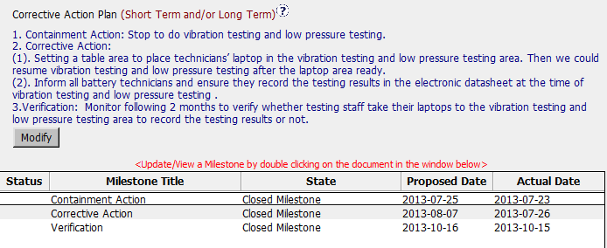
CAR# 133912082 (Corrective Action)
Firstly containment actions were taken to stop testing before the right data recording method conducted.
Two Corrective actions were logically linked with root causes identified.
Verification was planned to ensure actions would be sustained.
Three milestones were setup to put actions into implementation, and all milestones were closed timely.
[Collaboration] (C L) – To be improved by working with CAR Owner to get the reasonable CA Plan that is able to fix the root cause.
[Competitiveness] (C) – To be improved by engaging with CAR Owner to fix the objective evidence and other problems found.
[Integrity] (P) – To be improved of determination by declining the insufficient CA Plan.
One comment, may consider to separate into two milestones for two corrective actions if they were actually completed in different schedule.
Notes:
Corrective Actions – fix the objective evidence
If it only addresses the Containment to the “Root Cause” recorded above, I think it is sufficient…
However, the reason of why failure conducting of previous Management Review is not addressed in the fields of “Root Cause” and “Correction Action Plan”.
Corrective Actions – address the entire root cause
As noted above, it is sufficient to cover the containment action though, the corrective action managing the root cause has not been addressed.
Again, there is no any corrective action related to address why “Recommendation for improvement” is not covered as input in the process of Management Review stated in the current DEWI Quality Manual.
Corrective Actions – address the items identified in the analysis
As noted above.
Corrective Actions – cover the scope and geography
Comment as stated in “Geography” above.

Slide 6
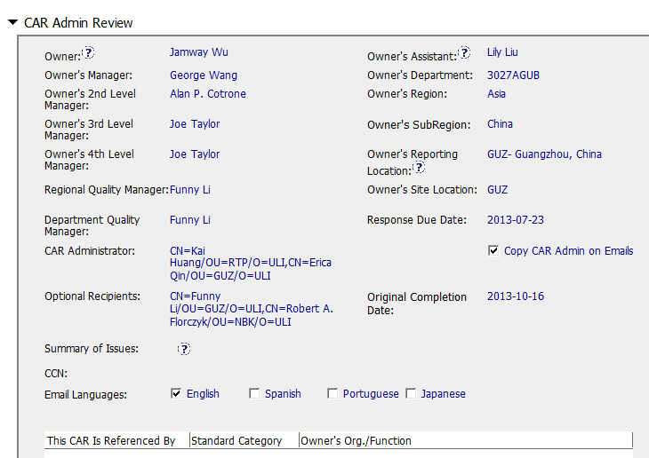
CAR# 133912082 (CAR Admin Review)
Good and No Abnormality
The 3rd level manager was changed to Joe from Ben Miller
This sometimes may be ignored when 4th level was well default there.
[Collaboration] (C L) – Good. CAR Owner, CAR Escalation Path and Optional Recipients are set appropriately.
Notes:
Good and no abnormality is found.

Slide 7
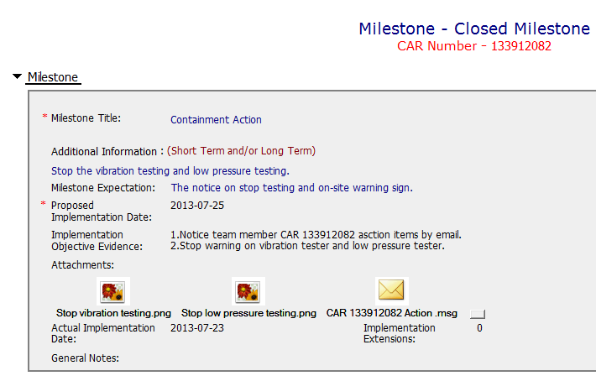
CAR# 133912082 (Milestone_1)
Milestone for containment is good with evidences provided.
[Collaboration] (L, C L) – Good. Containment and its supporting evidence are reviewed appropriately.
Notes:
Milestones – address containment unless CAP indicates reason why not required
Milestone solely for containment is good but not for corrective action. [Suggest to inviting a person could read German for verification whether “Recommendation for improvement” is now covered as input in the process of Management Review.]
See below comments for corrective actions.

Slide 8
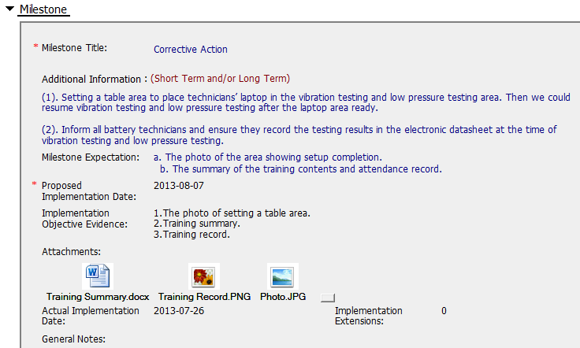
CAR# 133912082 (Milestone_2)
Milestone for containment is good with evidences provided.
[Collaboration] (L, C L) – Expectation was setup with CAR owner.
[Competitiveness] (P) – CAR Owner complete d milestone as per expectation.
[Integrity] (P) – Milestone was completed, reviewed and completed in time.
Notes:
Milestones – have final milestone for owner’s verification of effectiveness; enough time is allowed for new records to be examined
Although CAR owner self-verification is added at the last milestone, it doesn’t cover the corrective action for the failure conducting previous Management Review.
In fact, would the next round of Management Review be able to conducted on-time, it has not been addressed.
It is suggested that the verification should focus on whether the updated process and/or next round of Management Review is in place to avoid recurrence of such nonconformity.
Milestones – completed per milestone expectations
It is acceptable as Containment Action for the supporting evidence covered in the 1st milestone, i.e. Management Review Report for Year 2011 and Year 2012 [Suggest to inviting a person could read German for verification…].
However, the evidence “Attachment of the management review 2013 in milestone one. The effectiveness of the management review was reviewed by the EULA Region Quality Manager and found to be acceptable.” stated in the 2nd milestone is irrelevant while the Management Review for Year 2013 has not been conducted yet. Not sure how CAR Administrator accepts it.
In addition, for 2nd milestone, it is suggested that a statement should be provided by CAR Owner to indicate that “Recommendation for improvement” is now covered as input in the process of Management Review for Year 2011 and 2012...

Slide 9
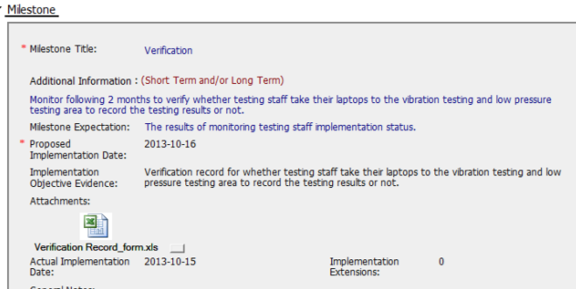
CAR# 133912082 (Milestone_3)
Milestone for containment is good with evidences provided.
[Collaboration] (L, C L) – Expectation was setup with CAR owner.
[Competitiveness] (P) – CAR Owner complete d milestone as per expectation.
[Integrity] (P) – Milestone was completed, reviewed and completed in time.
Notes:
Milestones – have final milestone for owner’s verification of effectiveness; enough time is allowed for new records to be examined
Although CAR owner self-verification is added at the last milestone, it doesn’t cover the corrective action for the failure conducting previous Management Review.
In fact, would the next round of Management Review be able to conducted on-time, it has not been addressed.
It is suggested that the verification should focus on whether the updated process and/or next round of Management Review is in place to avoid recurrence of such nonconformity.
Milestones – completed per milestone expectations
It is acceptable as Containment Action for the supporting evidence covered in the 1st milestone, i.e. Management Review Report for Year 2011 and Year 2012 [Suggest to inviting a person could read German for verification…].
However, the evidence “Attachment of the management review 2013 in milestone one. The effectiveness of the management review was reviewed by the EULA Region Quality Manager and found to be acceptable.” stated in the 2nd milestone is irrelevant while the Management Review for Year 2013 has not been conducted yet. Not sure how CAR Administrator accepts it.
In addition, for 2nd milestone, it is suggested that a statement should be provided by CAR Owner to indicate that “Recommendation for improvement” is now covered as input in the process of Management Review for Year 2011 and 2012...

Slide 10
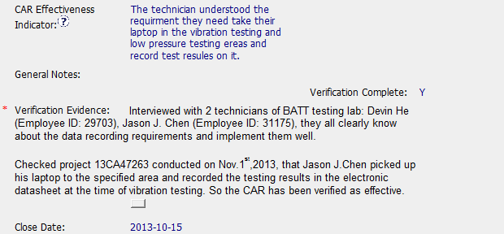
CAR# 133912082 (Verification)
This CAR was verified with checking both actual project and technicians who conducted testing.
Verification was concluded effective.
One comment: This CAR was verified on Nov 8, which was quite close to the close date of last milestone (Oct 15).
[Collaboration] (C L) – Proactively working with CAR Owner to verify the effectiveness of the agreed CA Plan.
[Integrity] (P, T) –Reasonable verification evidences provided and sufficient verification to be considered.
Notes:
Verification – completed within 6 months of CAR closure or explanation provided; enough time is allowed for new records to be examined
Please be noted that this CAR hasn’t been closed yet. It is still under a state of “Closed Awaiting Verification”, hence, the field of “Verification Evidence” is still kept empty.
However, when both root cause identification and the related corrective action stated in 2nd milestone are questionable, the comment “The corrective action was effective” stated in the field of “CAR Effectiveness Indicator” shows too generic and lack of logical consideration…
If I were the CAR Administrator, will suggest the CAR Owner to reconsider the revisit of the current Management Review process and hence fill up the loophole resulting this nonconformance by adding one or two more milestones to illustrate and support the proper completion of corresponding efforts / activities. The timeline of last milestone for CAR Owner self-verification could be set right after completion of Management Review for Year 2013.
For the “General Notes”, shouldn’t it be an analysis field provided by CAR Owner instead of CAR Admin?

